Slide 1
Proportions & Odds Ratios
SMU_6372-403 – Applied Statistics
Jack K. Rasmus-Vorrath
7/6/17

Slide 2
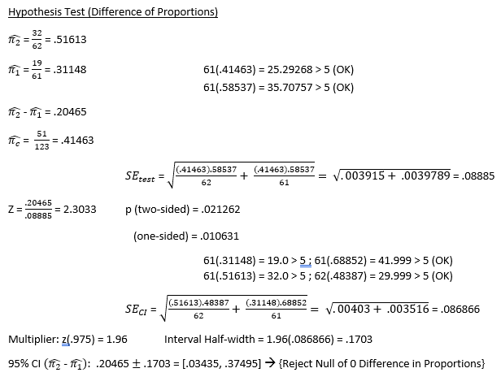

Preschool|Crime : Difference in Proportions
In assessing this PROSPECTIVE study on the effect of preschool attendance on subsequent criminal activity,
an analysis of the difference in two population proportions was first conducted.
When comparing the difference of proportions, the
hypothesis test resulted in a determination of
statistical significance at the alpha = .05 level
(1-sided p-value = .010631), suggesting that
preschool attendance effectively deters subjects
from criminal activity later in life. A confidence interval that excludes the value of 0 is consistent
with this finding.

Slide 3
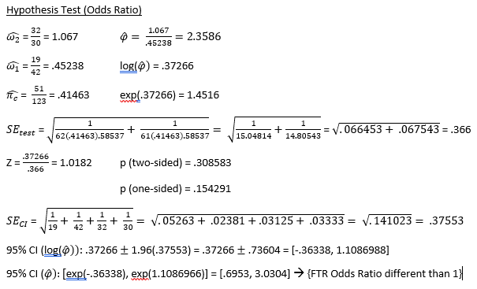
Preschool|Crime: Odds Ratio
However, when a second test of the odds ratio associated with subsequent criminal activity was conducted, the analysis produced a conflicting result, more sensitive to the difference in between-group odds.
When analyzing the odds ratio, the hypothesis test resulted in
a determination of no statistical significance at the
alpha = .05 level (1-sided p-value = .15491), suggesting that one cannot make any substantive claims
regarding the effect of preschool attendance on
criminal activity later in life. Because the confidence
interval included the value of 1, one cannot assert with
any surety that the odds associated with the event of
interest are not even.

